Slide 1
[Title of School Counseling Program’s Flashlight Presentation]
[School Name’s] School Counseling Department
[Insert School Photo/ Mascot Image/ Counseling Program Photo]
[Insert school counselor names]
Hatching Results®
Notes:
*The Flashlight Presentation has been adapted from The Use of Data in School Counseling: Hatching Results® for Students, Programs, and the Profession
by Trish Hatch, Hatching Results®. Visit chapters 11 and 12 for more support.
Title Slide: List your school name, counselor(s) involved, and activity and indicate that this is just a sample of results from your intentional guidance (small group counseling, closing-the gap, or other targeted intervention).

Slide 2
School Counseling Program Goal
[Write the relevant S.M.A.R.T. goal statement here]
Notes:
Brief background on the baseline data for this activity, if available, and action plan goal it was connected to.

Slide 3
Rationale
[Insert information about why you are teaching this curriculum/lesson using school data]
[Insert relevant data graphic from previous school years or complete this chart below]
[INSERT TOPIC/DATA METRIC SUCH AS G.P.A. OR SCHOOL CLIMATE]
PREVIOUS SCHOOL YEAR DATA 20XX – 20XX | PREVIOUS SCHOOL YEAR DATA 20XX – 20XX | DATA GOAL 20XX – 20XX
[Insert previous school year data] | [Insert previous school year data] | [Insert school data goal]
Notes:
Why intervene? Why address this concern? What does the research or data say? Include quotes from research and/or baseline school data

Slide 4
Rationale
[Insert quote from research or survey results] Lduewldigy souero gxoe doqog ouwdy. Lqucbd pyeob mkelwi ydgwp bxokf jhuwlm veoqxj.
--Name of Source
Year
[Insert screenshots of article/research publications (OPTIONAL)]
Notes:
Why intervene? Why address this concern? What does the research or data say? Include quotes from research and/or baseline school data, survey results/feedback from teachers, parents, etc.

Slide 5
Student Standards: ASCA Mindsets & Behaviors
ASCA MINDSET STANDARD
[Insert ASCA Mindset Standard in format such as:
M 3. Sense of belonging in school environment]
ASCA BEHAVIOR STANDARDS
[Insert multiple ASCA Behavior Standard(s) in format such as: B-SMS 2: Demonstrate self-discipline and self-control
B-SMS 7: Demonstrate effective coping skills when faced with a problem
B-SS 2: Create positive and supportive relationships with other students]
Notes:
Identify the applicable ASCA Mindsets & Behaviors for Student Success: K-12 College- and Career Readiness for Every Student that describe the knowledge, skills and attitudes students need to achieve academic success, college and career readiness and social/emotional development. https://schoolcounselor.org/asca/media/asca/home/MindsetsBehaviors.pdf

Slide 6
Student Standards: ASCA Mindsets & Behaviors
ASCA COMPETENCY
[Insert ASCA Competency in format such as:
Write out competency (Grade Level)]
Recount or describe key ideas or details from a text read aloud or information presented orally or through other media about a conflict or disagreement. (Grades K-2)
ASCA COMPETENCY
[Insert ASCA Competency in format such as:
Write out competency (Grade Level)]
Notes:
Identify the applicable grade-level competencies, which are specific, measurable expectations that students attain as they make progress toward the standards. These are your learning objectives.

Slide 7
Other Standards: [Insert Name of Standards] (OPTIONAL)
[INSERT NAME OF STATE/LOCAL STANDARD]
[Insert identified standard(s)]
[INSERT NAME OF STATE/LOCAL STANDARD]
[Insert identified standard(s)]
Notes:
If your state/district have other important standards that you align your work to, include them here.

Slide 8
Process Data
[IDENTIFY STUDENT GRADE LEVEL OR GROUP]
Insert bulleted list with details about how
[Insert text: When? Days/months]
[Insert text: What frequency/how often?]
[Insert text: Where? Which class?]
[Insert text: How many students impacted?]
[Insert Graphic/ Image of Curriculum/ Photo, etc. (OPTIONAL)]
Notes:
Refer to the data located in your action plan and Program Results Report.

Slide 9
Process Data
LESSONS INCLUDED THE FOLLOWING TOPICS:
Insert bulleted list with details
[Insert text]
[Insert text]
[Insert text]
[Insert Graphic/ Image of Curriculum/ Photo, etc. (OPTIONAL)]
Notes:
Refer to the data located in your action plan and Program Results Report.

Slide 10
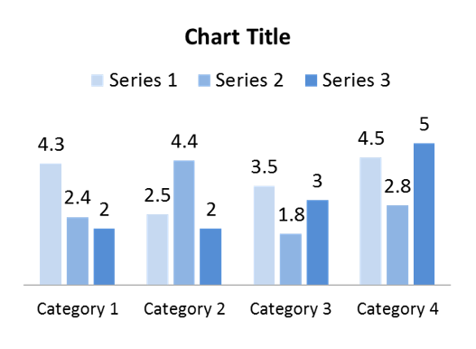
Perception Data
[Insert Statement Regarding Perception Data]
Notes:
What do students know, believe, or can do? Perception Data (Attitude, Knowledge or Skill): List here the results of your pre-post tests or other perception data. Can duplicate this slide to add slides of more pre-post data pieces that you believe will be beneficial to your presentation. While you may have collected results on several different ASK (Attitudes, Knowledge and Skills) items, it is best not to share every pre-post item as it will make the presentation too long. Instead, select the most appropriate ones that will support your message – and consider sharing ALL your results in another format or a corresponding handout.
Add Graphic Representation of Perception Data: Presenting the data in a graph form can really make the difference visualizing student gains.

Slide 11
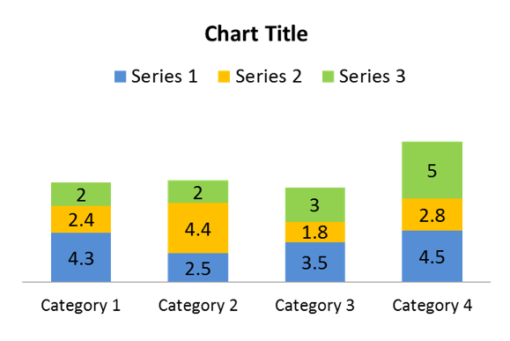
Outcome Data
[Insert Statement Regarding Outcome Data]
Notes:
This slide will contain your achievement related data – behavior, attendance, and student academics. Add graphical representations of data whenever possible and duplicate this slide if necessary.

Slide 12
Summary and Implications
[Insert summary bulleted list of your results and the overall impact of your curriculum]
Cont.
Cont.
Cont.
Notes:
Was the goal met? Indicate your overall reflections of what worked and the impact and the conclusions that can be drawn.
a likely consequence of something.
Implications ~ Next Steps or Areas for Improvement:
Tell what you learned from this. Indicate what you might do differently next time. Share the following: The program was (or was not) effective and remember not to take all of the credit.

Slide 13
Limitations (OPTIONAL)
[Insert bulleted list of challenges encountered]
Cont.
Cont.
Cont.
Notes:
This is optional if you want to mention issues that you feel negatively impacted your results as it relates to next steps and lessons learned in next slide.

Slide 14
Lessons Learned and Next Steps
[Insert bulleted list of the next steps in your school counseling program]
Cont.
Cont.
Notes:
What did you learn as a result of this work? What worked and what didn’t? How will you improve or do differently next time? What direction is the school counseling program moving towards next? What actions will you take next—present this Flashlight to the School Board?

Slide 15
THANK YOU!! Many thanks to Administration, Staff, and Parents for contributions to these efforts and your support of the school counseling program!
15
Notes:
Thank you:
Thank the staff (or your target audience) for their support. And thank the administrator for the time – offer to take questions at the end and check to see that you stayed (hopefully) under 5 minutes!!

Slide 16
[Insert School Name] Counseling Program
[Insert School Counseling Program Mission and/or Vision Statement(s)]
[Insert photo of school counselor/counseling team or graphic (OPTIONAL)]
16
Notes:
Thank you:
Thank the staff (or your target audience) for their support. And thank the administrator for the time – offer to take questions at the end and check to see that you stayed (hopefully) under 5 minutes!!

Slide 17
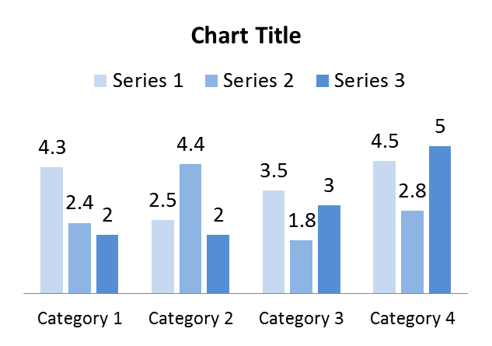
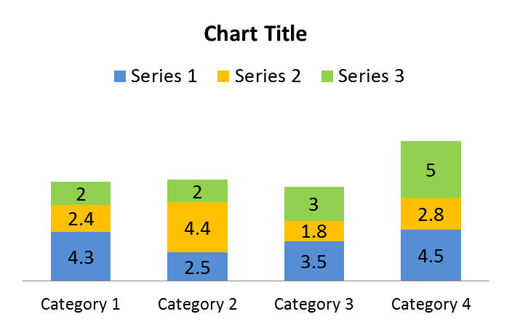
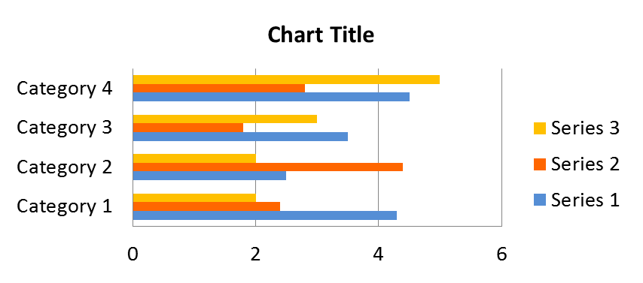
Column/Bar Chart Samples [REFERENCE ONLY – DELETE SLIDE]
Office name goes here
Notes:
Reference of visual data representations

Slide 18
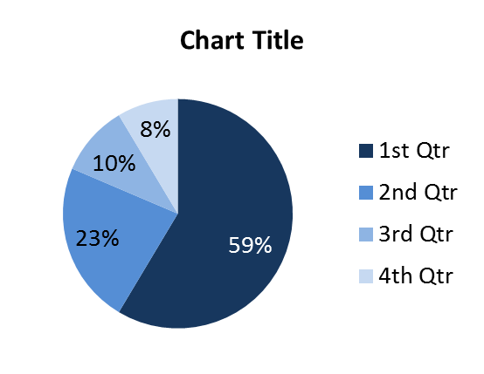
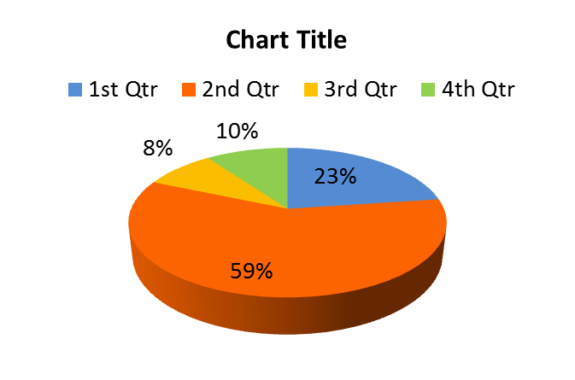
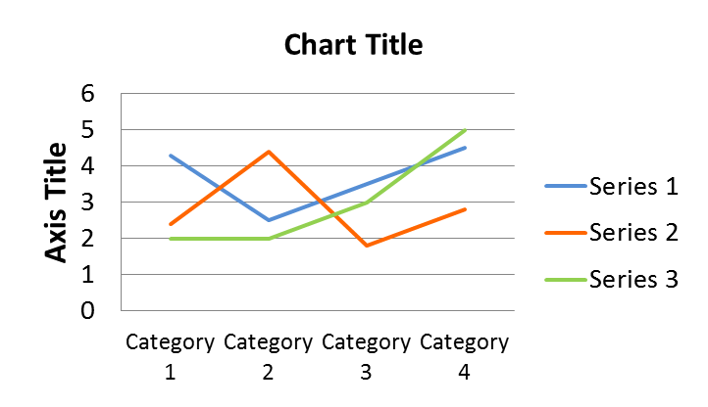
Pie/Line Chart Samples [REFERENCE ONLY – DELETE SLIDE]
Office name goes here

Slide 19
Table Samples [REFERENCE ONLY – DELETE SLIDE]
This is sample test | This is sample test
This is just sample test | This is just sample test
This is just sample test | This is just sample test
This is just sample test | This is just sample test
This is just sample test | This is just sample test
This is sample text
1 | This is just sample text
2 | This is just sample text
3 | This is just sample text
4 | This is just sample text
5 | This is just sample text
6 | This is just sample text
This is sample text
This is just sample text | This is just sample text | This is just sample text | This is just sample text
This is just sample text | This is just sample text | This is just sample text | This is just sample text
Notes:
Reference of tables that can be used for listing process data and interventions

