Slide 1
Hey, Hey, Hey… Let’s Calculate that GPA!
School Counseling Classroom Lesson:
Grades Matter & GPA Calculation
Presented By:
Potter High School Counselors
Ms. Duarte & Ms. LaBare
‹#›

Slide 2
School Counseling Department
Ms. Duarte
School Counselor
Students Last Name M-Z
Ms. LaBare
School Counselor
Students Last Name A-L
School Counselors Support Student Success by…
Help students create & achieve their post-secondary goals
Planning events like College & Career Fairs, Suicide Awareness Week, & College Signing Day
Creating a safe school environment for all
Talking to students about problems at school or personally
Teach lessons & facilitate small groups on a variety of academic, college/career, and social/emotional topics
Mrs. Hernandez
School Counseling Clerk
‹#›

Slide 3
Behavior Expectations
Complete Guided Notes Worksheet
‹#›

Slide 4
Lesson Objectives & Standards
By the end of the lesson, we will be able to…
Understand the importance of our grades
Explain the required & competitive GPA for college admission and for high school athletic/extra-curricular eligibility
Calculate our Grade Point Average (GPA)
ASCA Mindsets & Behavior Standards
M 2. Self-confidence in ability to succeed
B-LS 8. Actively engage in challenging coursework
B-LS 10. Participate in enrichment and extracurricular activities
‹#›

Slide 5
What We Already Know about Grades…
On the index card, please write:
Your first and last name
Two or more reasons grades are important
Ms. Duarte

Slide 6
Grades Matter!!!
What are reasons that grades matter?
HIGH SCHOOL
Graduation!!!
Sports eligibility
Participation in clubs & other school activities
AFTER HIGH SCHOOL
Meet requirements & be competitive for college admission & other post-secondary options
Earn scholarships (FREE money!)
‹#›

Slide 7
Grades Matter!!!
Study of 187,000 high school freshmen found…
How well students performed academically in 9th grade predicted students’ future success
9th graders with A’s, B’s, and C’s were much more likely to graduate high school than their classmates with lower grades
Academically strong 9th graders were more likely to attend college
US News & World Report, 2017
‹#›

Slide 8
Grades Matter - Graduation
Total of 220 credits needed to graduate
Credits are “points” you receive for each class you pass with a D or higher
Passing one full year class at Potter HS = 10 credits
Students generally earn 60 credits each year (6 classes x 10 credits per class = 60)
If you get an F in a required class you have to take the class again ☹
‹#›

Slide 9
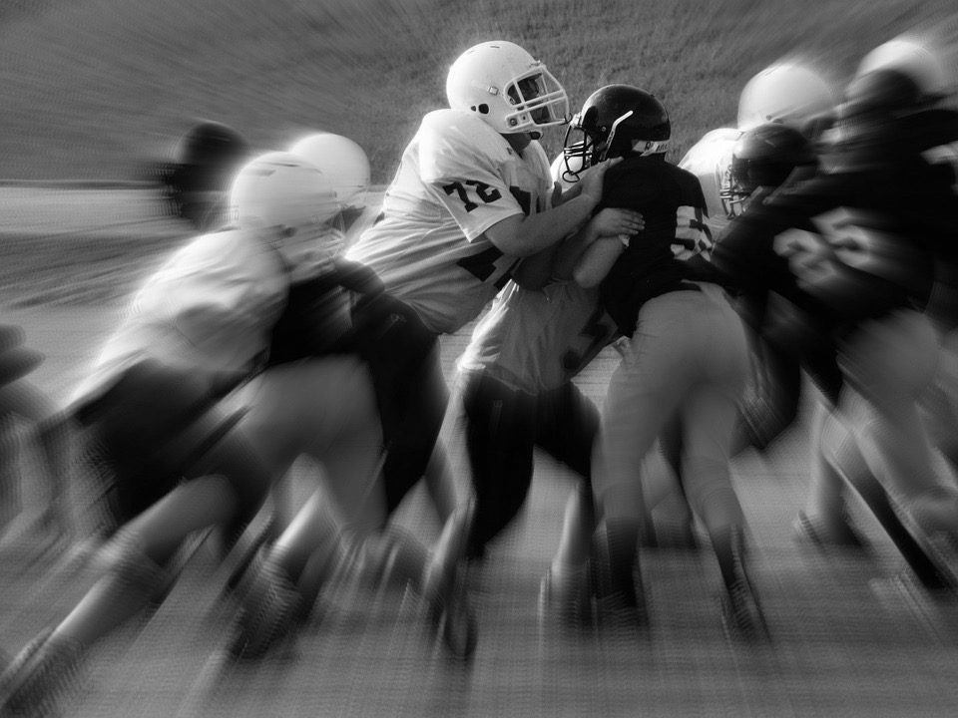
Grades Matter – Sports & Activities
Student athletes must maintain a 2.0 GPA
No more than 1 F on quarter progress report or final report card
Students need 2.0 or higher to be club leaders, attend college fieldtrips, and earn a work permit
‹#›

Slide 10
Grades Matter – College
THINK-PAIR-SHARE
What are your post-secondary goals?
What can do you do now to get there?
‹#›

Slide 11
College Eligibility Requirements
A-G Requirements
Classes required to take and pass to attend most California colleges (UCs and CSUs)
A: History (2 years)
B: English (4 years)
C: Math (3 years)
D: Science (2 years)
E: Foreign Language (2 years)
F: Visual and Performing Arts (1 year)
G: College Preparatory Elective (1 year)
You must receive a C- or higher in A-G classes for them to count towards college.
‹#›

Slide 12
College Eligibility Requirements
California State Universities (CSUs)
GPA’S of 2.0 or above are eligible
Accepted students generally had GPA 3.2+
University of California (UCs)
GPA’S of 3.0 or above are eligible
Accepted students generally had GPA 3.5-4.0+
Must meet A-G requirements & take SAT or ACT
Work hard to keep your GPA high to be competitive for college!
What are examples of UCs & CSUs?
‹#›

Slide 13
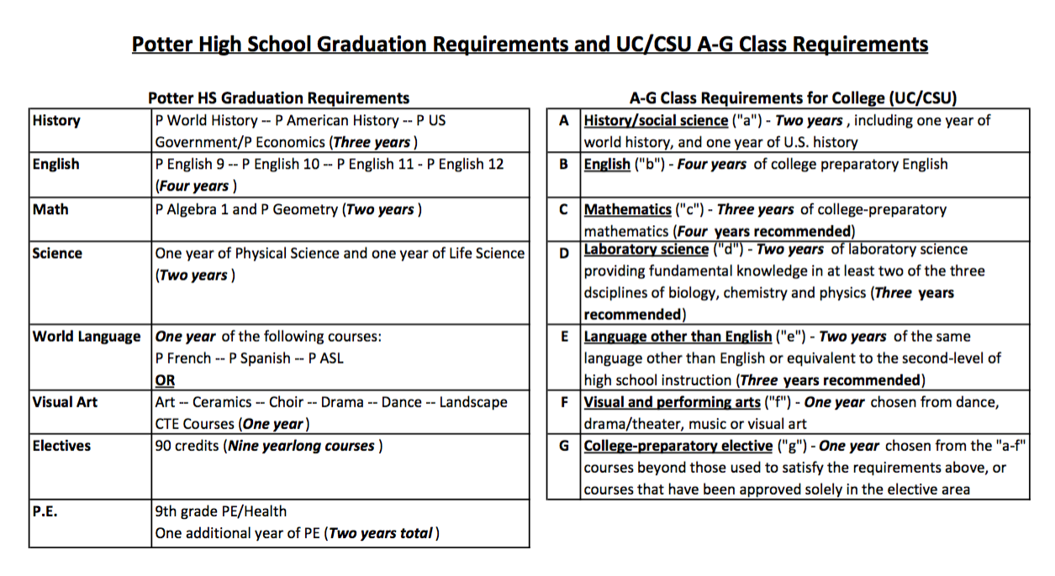
High School Class & A-G College Eligibility Requirements
‹#›

Slide 14
What is GPA?
Abbreviation for Grade Point Average
Points are earned for each semester letter grade
College Prep/Non-Honors/Non-AP
Honors & AP Classes
Grade | Points
A | 4
B | 3
C | 2
D | 1
F | 0 ☹
Grade | Points
A | 5
B | 4
C | 3
D | 1
F | 0 ☹
‹#›

Slide 15
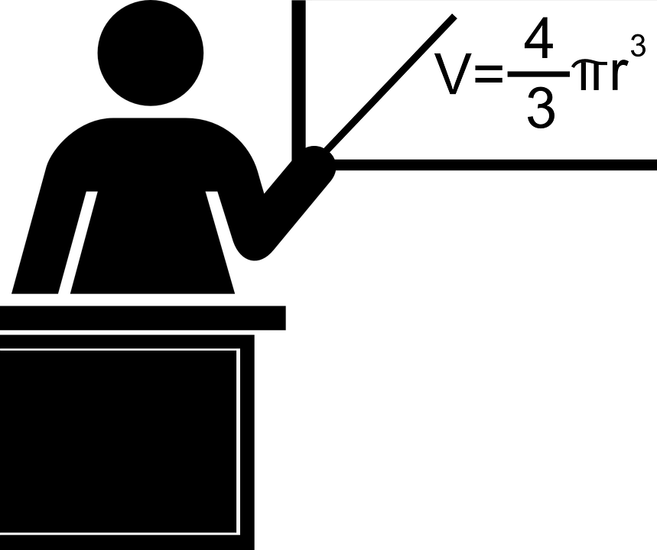
How Do We Calculate GPA?
Total grade points
divided by
# of classes
=
Grade Point Average (GPA)
‹#›

Slide 16
Let’s Practice Calculating GPA
3
4
1
2
0
4
Algebra 1 B =
Honors English 9 B+ =
Chemistry D =
World History C =
Spanish 1 F =
PE A- =
+
+
14 GPA points
‹#›

Slide 17
Let’s Practice Calculating GPA
Total grade points
divided by
# of classes
=
Grade Point Average (GPA)
14 GPA points
divided by
6 classes
=
2.33 GPA
‹#›

Slide 18
Now it’s Your Turn…Calculate Your GPA Based on 1st Quarter Grades
Logon to your StudentVue account
Website: www.PotterStudentVue.com
Login: Student ID number
Password: Initials (lower case) + birthdate
‹#›

Slide 19
Now it’s Your Turn…Calculate Your GPA Based on 1st Quarter Grades
Total grade points ➗ # of classes = GPA
College Prep/Non-Honors/Non-AP
Honors & AP Classes
Grade | Points
A | 4
B | 3
C | 2
D | 1
F | 0
Grade | Points
A | 5
B | 4
C | 3
D | 1
F | 0
‹#›

Slide 20
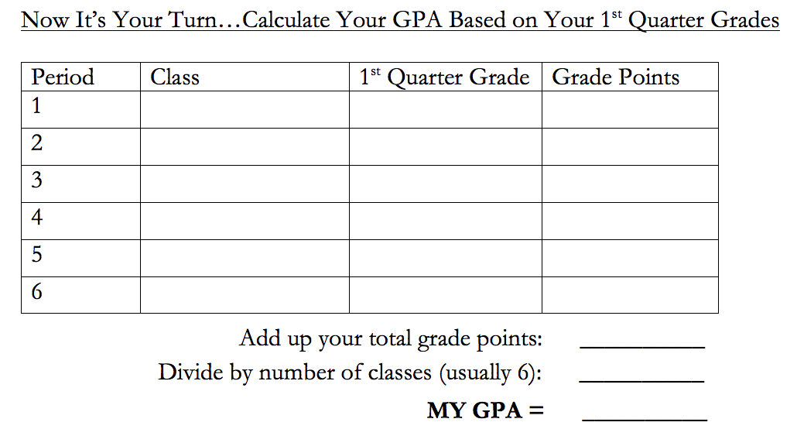
Now it’s Your Turn…Calculate Your GPA Based on 1st Quarter Grades
End

Slide 21
Are Your Grades Low?
Here are your options…
Check your StudentVue account weekly & make up missing assignments
Organize your backpack & use your planner
Dedicate time for homework & studying
Attend weekly tutoring
Tuesdays & Thursdays in library
Wednesdays at lunch in room 33
Practice math skills on Khan Academy
‹#›

Slide 22
Credit Recovery
Make up classes through summer school
Sign up for Apex online courses
Restart classes next semester
You can do it!!!
We are here for you!!!
‹#›
Notes:
https://pixabay.com/en/school-supplies-school-color-cup-3109465/

Slide 23
Our Goal
ALL students will graduate with their class!!!
‹#›

Slide 24
Lesson Objectives Review
Grades are important because ____________
The required GPA for attending the CSU’s is ____ and for the UC’s is ______. (But remember, to be competitive, keep your GPA even higher!)
In order to play sports in high school, a GPA of ___ is needed.
We can calculate our Grade Point Average!
‹#›

Slide 25
Post-Test Show What You Know
Go to the GoogleForms link
‹#›

