Slide 1
[Title of School Counseling Programs Tier 2 Intervention
Flashlight Presentation]
[School Name’s] School Counseling Department
[Insert School Photo/ Mascot Image/ Counseling Program Photo]
[Insert school counselor names]
From The Use of Data in School Counseling: Hatching Results for Students, Programs, and the Profession by Trish Hatch, PhD
Hatching Results®, LLC
Notes:
*The Flashlight Presentation has been adapted from The Use of Data in School Counseling: Hatching Results® for Students, Programs, and the Profession
by Trish Hatch, Hatching Results®. Visit chapters 11 and 12 for more support.
Title Slide: List your school name, counselor(s) involved, and activity and indicate that this is just a sample of results from your intentional guidance (small group counseling, closing-the gap, or other targeted intervention).

Slide 2
School Counseling Program Goal
[Write the relevant
Tier 2 Intervention S.M.A.R.T. goal statement here]
School Name – School Counseling Department
Notes:
Brief background on the baseline data for this activity, if available, and action plan goal it was connected to.

Slide 3
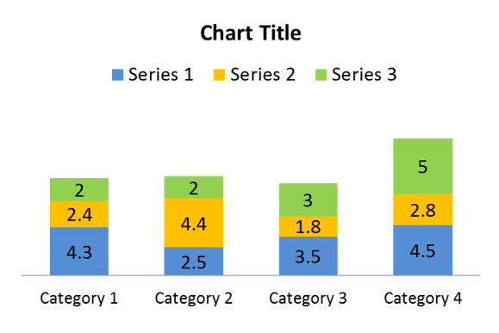
Target Group: Name group
[The target group was selected on the basis of?
Insert information about who is the target group]
[Which students did you target to intervene with?]
[What data led you to intervene with these particular students?]
School Name – School Counseling Department
Notes:
Which students did you target to work with and why?

Slide 4
Rationale
[Insert quote from research or survey results supporting the rationale for intervention ]
--Name of Source
Year
[Insert screenshots of article/research publications (OPTIONAL)]
School Name – School Counseling Department
Notes:
Why intervene?
Why address this concern?
What does the research or data say? Include quotes from research and/or baseline school data, survey results/feedback from teachers, parents, etc.

Slide 5
Student Standards: ASCA Mindsets & Behaviors
ASCA COMPETENCY
[Insert ASCA Competency in format such as:
Write out competency (Grade Level)
Recount or describe key ideas or details from a text read aloud or information presented orally or through other media about a conflict or disagreement. (Grades K-2)]
ASCA COMPETENCY
[Insert ASCA Competency in format such as:
Write out competency (Grade Level)]
School Name – School Counseling Department
Notes:
Identify the applicable grade-level competencies, which are specific, measurable expectations that students attain as they make progress toward the standards. These are your learning objectives.

Slide 6
Other Standards: [Insert Name of Standards] (OPTIONAL)
[INSERT NAME OF STATE/LOCAL STANDARD]
[Insert identified standard(s)]
[INSERT NAME OF STATE/LOCAL STANDARD]
[Insert identified standard(s)]
[INSERT NAME OF STATE/LOCAL STANDARD]
[Insert identified standard(s)]
[INSERT NAME OF STATE/LOCAL STANDARD]
[Insert identified standard(s)]
School Name – School Counseling Department
Notes:
If your state/district have other important standards that you align your work to, include them here.

Slide 7
Pre-Intervention Survey
[Discuss how you determined that small group was the appropriate intervention]
School Name - School Counseling Department
Notes:
If you gave a survey to determine an appropriate intervention, explain how that data was utilized to determine interventions

Slide 8
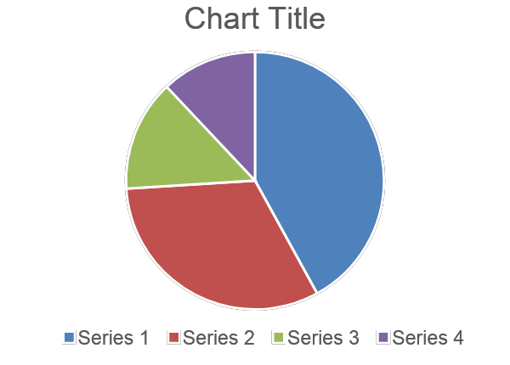
Process Data (Pt 1)
[INSERT TYPE OF SERVICE/ACTIVITY/INTERVENTION]
Insert bulleted list with details
What action, frequency
How many students impacted
What curriculum/materials,
Key collaborators
[INSERT GRAPHIC, IMAGE OF CURRICULUM, PHOTO, ETC. (OPTIONAL])
School Name – School Counseling Department

Slide 9
Process Data (Pt 2)
[INSERT TYPE OF SERVICE/ACTIVITY/INTERVENTION]
Insert bulleted list with details
What action, frequency
How many students impacted
What curriculum/materials,
Key collaborators
[INSERT GRAPHIC, IMAGE OF CURRICULUM, PHOTO, ETC. (OPTIONAL])
School Name – School Counseling Department

Slide 10
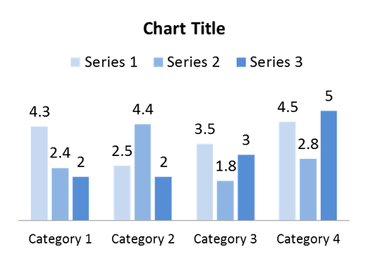
Perception Data: Attitudes
[Insert Statement Regarding Perception Data]
School Name – School Counseling Department
Notes:
Perception Data (Attitude, Knowledge or Skill): List here the results of your pre-post tests or other perception data. Can duplicate this slide to add slides of more pre-post data pieces that you believe will be beneficial to your presentation. While you may have collected results on several different ASK (Attitudes, Knowledge and Skills) items, it is best not to share every pre-post item as it will make the presentation too long. Instead, select the most appropriate ones that will support your message – and consider sharing ALL your results in another format or a corresponding handout.
Add Graphic Representation of Perception Data: Presenting the data in a graph form can really make the difference visualizing student gains.

Slide 11
Perception Data: Knowledge
[Insert Statement Regarding Perception Data]
School Name – School Counseling Department
Notes:
Perception Data (Attitude, Knowledge or Skill): List here the results of your pre-post tests or other perception data. Can duplicate this slide to add slides of more pre-post data pieces that you believe will be beneficial to your presentation. While you may have collected results on several different ASK (Attitudes, Knowledge and Skills) items, it is best not to share every pre-post item as it will make the presentation too long. Instead, select the most appropriate ones that will support your message – and consider sharing ALL your results in another format or a corresponding handout.
Add Graphic Representation of Perception Data: Presenting the data in a graph form can really make the difference visualizing student gains.

Slide 12
Perception Data: Skills
[Insert Statement Regarding Perception Data]
School Name – School Counseling Department
Notes:
Perception Data (Attitude, Knowledge or Skill): List here the results of your pre-post tests or other perception data. Can duplicate this slide to add slides of more pre-post data pieces that you believe will be beneficial to your presentation. While you may have collected results on several different ASK (Attitudes, Knowledge and Skills) items, it is best not to share every pre-post item as it will make the presentation too long. Instead, select the most appropriate ones that will support your message – and consider sharing ALL your results in another format or a corresponding handout.
Add Graphic Representation of Perception Data: Presenting the data in a graph form can really make the difference visualizing student gains.

Slide 13
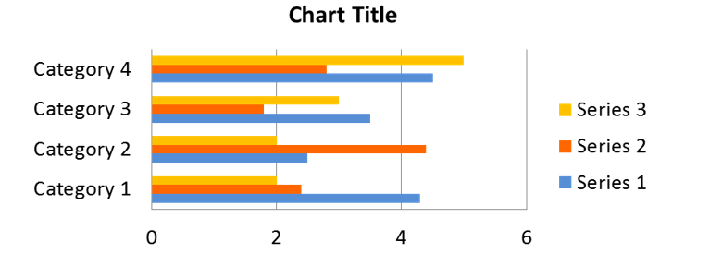
Outcome Data
[Insert Statement Regarding Outcome Data]
School Name – School Counseling Department
Notes:
Outcome Data: This slide will contain your achievement related data – behavior, attendance, and student academics. Add graphical representations of data whenever possible and duplicate this slide if necessary.

Slide 14
Summary and Implications
[Insert a summary bulleted list of your results and the overall impact of your counseling activity]
Cont.
Cont.
School Name – School Counseling Department
Notes:
Indicate your overall reflections of what worked and the impact and the conclusions that can be drawn.
a likely consequence of something.
Implications ~ Next Steps or Areas for Improvement:
Tell what you learned from this. Indicate what you might do differently next time. Share the following: The program was (or was not) effective and remember not to take all of the credit.

Slide 15
Limitations (OPTIONAL)
[Insert bulleted list of challenges encountered]
Cont.
Cont.
School Name – School Counseling Department
Notes:
This is optional if you want to mention issues that you feel negatively impacted your results as it relates to next steps and lessons learned in next slide.

Slide 16
Lessons Learned and Next Steps
[Bulleted list of the next steps in your school counseling program]
Cont.
Cont.
School Name – School Counseling Department
Notes:
What did you learn as a result of this work? What worked and what didn’t? How will you improve or do differently next time? What direction is the school counseling program moving towards next?

Slide 17
THANK YOU! Many thanks to administration, staff, and parents for your contributions to these efforts and your support of the
school counseling program!
School Name – School Counseling Department
14
Notes:
Thank you:
Thank the staff (or your target audience) for their support. And thank the administrator for the time – offer to take questions at the end and check to see that you stayed (hopefully) under 5 minutes!!

